Slide 1
Controlling the flow If, else, Elif
Programming and Scripting
Andrew.Beatty@atu.ie
P 4.1

Slide 2
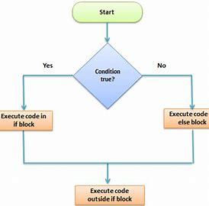
This Lecture
Structured programming theorem
Programming is Encoding a system
booleans
If statements
Else statements
elif

Slide 3
Structured programming theorem
Executing one subprogram, and then another subprogram (sequence)
Executing one of two subprograms according to the value of a boolean expression (selection)
Repeatedly executing a subprogram as long as a boolean expression is true (iteration)

Slide 4
Structured programming theorem
Executing one subprogram, and then another subprogram (sequence)
Executing one of two subprograms according to the value of a Boolean expression (selection)
Repeatedly executing a subprogram as long as a boolean expression is true (iteration)

Slide 5

What that means
normal
If else
start
Statement 1
Vs
Statement 2
Statement 3

Slide 6
Boolean
Operator | Description
== | Is equal Not to be confused with = assigns
!= | Not equal
< > | Less than Greater than
<= >= | Less than or equal Greater than or equal
isInstance | Variable is of type
and or not | Boolean operators
in | Is a variable in a object
We have already seen Boolean variable types
isTrue = True
There are Boolean operators
isSomething = (3 == 6)
isEven = (( 99 % 2) == 0 )

Slide 7
Boolean logic (WARNING, requires thinking)
Not
NOT | Input | = | Output
NOT | True | = | False
NOT | False | = | True
AND
OR
Input 1 | AND | Input 2 | = | Output
False | AND | False | = | False
True | AND | False | = | False
False | AND | True | = | False
True | AND | True | = | True
Input 1 | OR | Input 2 | = | Output
False | OR | False | = | False
True | OR | False | = | True
False | OR | True | = | True
True | OR | True | = | True

Slide 8
If else elif (syntax)
If elif else
if
If else
if condition:
statements
if condition:
statements
elif condition2
statements
else:
statements
indent
if condition :
statements
else:
statements

Slide 9
Stand up,
and make up a limerick with the word boolean in it ☺

